Slide 1

Dynamic Programming
By Alex Joslin

Slide 2
Definition
Dynamic Programming (DP) is a programming technique that aims to reduce the time complexity of recursive problems.
It can do this in 2 ways:
Memorization (top-down approach)
Tabulation (bottom-up approach)

Slide 3
Part 1
Memorization

Slide 4
Fibonacci Example
def fib(n): if n == 1: # base case 1 return 1 elif n == 0: return 0 # base case 2 else: return fib(n-1) + fib(n-2) print(fib(4))
fib(4)
fib(3)
fib(2)
1 0
fib(1)? fib(0)? 1 1 0
fib(2)? fib(1)? fib(1)? fib(0)?
fib(3)? fib(2)?
fib(4)?
fib(2)
fib(1)
fib(1)
fib(0)
fib(1)
fib(0)
1
1
0
1
0
Stack

Slide 5


fib(4)
def fib(n): if n == 1: # base case 1 return 1 elif n == 0: return 0 # base case 2 else: return fib(n-1) + fib(n-2) print(fib(4))
fib(3)
fib(2)
fib(2)
fib(1)
fib(1)
fib(0)
1
0
1
0
1 0
fib(1)? fib(0)? 1 1 0
fib(2)? fib(1)? fib(1)? fib(0)?
fib(3)? fib(2)?
fib(4)?
fib(1)
fib(0)
1
0
0
1
1
1
1
fib(1)
fib(0)
1
1
0
0
fib(1)
fib(1)
1
fib(0)
1
fib(2)
0
1
+ 0
1
0
fib(3)
1
fib(2)
1
2
+ 1
1
+ 0
fib(4)
3
+ 1
2
Stack
Final Answer: 3

Slide 6
Fibonacci Time Complexity
Time Complexity
fib(4)
Without Dynamic Programming:
O(2^{n})
fib(3)
fib(2)
With Dynamic Programming:
O(n)
fib(2)
fib(1)
fib(1)
fib(0)
fib(1)
fib(0)
1
1
0
1
0

Slide 7
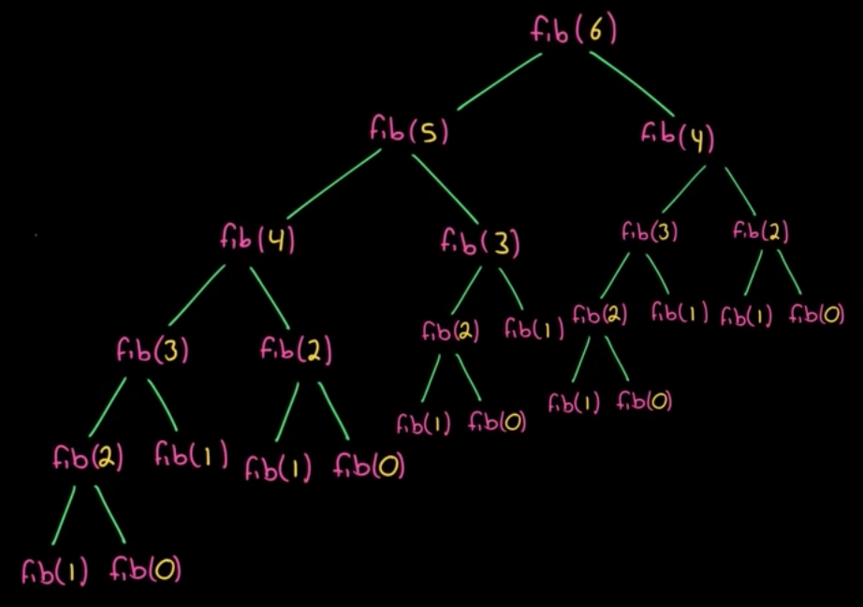
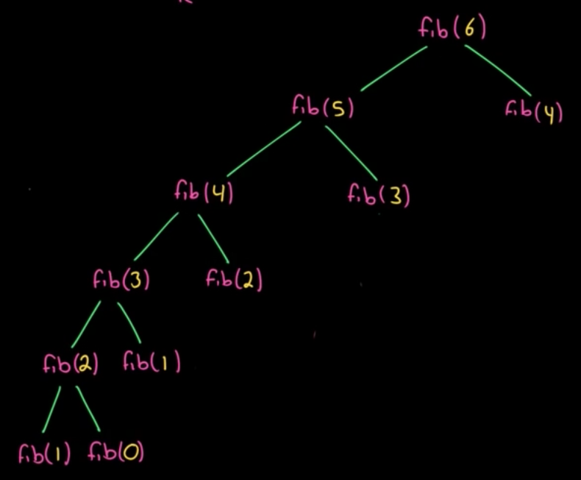
Comparison
Without DP
With DP

Slide 8
The Code
memo = [None, None, None, None, None] def fib(n): if n == 1: # base case 1 return 1 elif n == 0: # base case 2 return 0 elif memo[n] is None: memo[n] = fib(n-1) + fib(n-2) return memo[n] print(fib(4))
memo = {} def fib(n): if n == 1: # base case 1 return 1 elif n == 0: # base case 2 return 0 elif n not in memo: memo[n] = fib(n-1) + fib(n-2) return memo[n] print(fib(4))
def fib(n): if n == 1: # base case 1 return 1 elif n == 0: return 0 # base case 2 else: return fib(n-1) + fib(n-2) print(fib(4))
OUTPUT:
[None, None, None, None, None]
[None, None, None, None, None]
[None, None, None, None, None]
[None, None, None, None, None]
[None, None, None, None, None]
[None, None, 1, None, None]
[None, None, 1, 2, None]
[None, None, 1, 2, 3]
OUTPUT:
{}
{}
{}
{}
{}
{2: 1}
{2: 1, 3: 2}
{2: 1, 3: 2, 4: 3}

Slide 9
fib(4)
memo = {} def fib(n): if n == 1: # base case 1 return 1 elif n == 0: # base case 2 return 0 elif n not in memo: memo[n] = fib(n-1) + fib(n-2) return memo[n] print(fib(4))
3
fib(3)
fib(2)
2
1
fib(2)
fib(1)
fib(1)
fib(0)
1
OUTPUT:
{}
{}
{}
{}
{}
{2: 1}
{2: 1, 3: 2}
{2: 1, 3: 2, 4: 3}
fib(1)
fib(0)
1
1
0
1
0

Slide 10
Coding Challnege
Without dynamic programming

Slide 11
Minimum steps to one
Given an integer n, return the minimum steps to 1
AVAILABLE STEPS: Decrement by 1 If n is divisible by 2, divide by 2 If n is divisible by 3, divide by 3
Examples:
10 → 9 → 3 → 1 3 steps 15 → 5 → 4 → 2 → 1 4 steps 6 → 2 → 1 2 step

Slide 12
AVAILABLE STEPS: Decrement by 1 If n is divisible by 2, divide by 2 If n is divisible by 3, divide by 3
f(6)
f(5)
f(3)
f(2)
f(4)
f(2)
f(1)
f(1)
f(1)
f(3)
f(2)
f(1)
f(1)
0
0
0
f(2)
f(1)
f(1)
f(1)
0
0
f(1)
f(1)
0
0
0
0
0

Slide 13
Solution

Slide 14
f(6)
f(5)
f(2)
f(4)
f(1)
f(1)
# WITHOUT DP def steps(n): if n == 1: # Base Case return 0 if n % 3 == 0: return min(steps(n/3), steps(n-1)) + 1 elif n % 2 == 0: return min(steps(n/2), steps(n-1)) + 1 else: return steps(n-1) + 1
f(3)
f(2)
0
0
f(2)
f(1)
f(1)
f(1)
f(1)
f(1)
0
0
0
0
0

Slide 15
f(6)
/ 3
/2
f(5)
f(3)
f(2)
/3
/2
f(4)
f(2)
f(1)
f(1)
f(1)
f(3)
f(2)
f(1)
f(1)
0
0
0
f(2)
f(1)
f(1)
f(1)
0
0
f(1)
f(1)
0
0
0
Minimum path of these two
will always be the same
0
0
Any number that is divisible by 3 and 2 is also divisible by 6.
So it does not mater if you divide by 3 first or 2 first.

Slide 16
480 / 6 = 80
480 / 3 / 2 = 80
480 / 2 / 3 = 80
f(480)
/ 3
/ 2
f(479)
f(240)
f(160)
/ 3
/ 2
ect..
ect..
ect..
f(80)
ect..
f(80)
ect..
ect..

Slide 17
Coding Challnege
With dynamic programming
(Memorization)

Slide 18
AVAILABLE STEPS: Decrement by 1 If n is divisible by 2, divide by 2 If n is divisible by 3, divide by 3
f(6)
f(5)
f(3)
f(2)
f(4)
f(2)
f(1)
f(1)
f(1)
f(3)
f(2)
f(1)
f(1)
0
0
0
f(2)
f(1)
f(1)
f(1)
0
0
f(1)
f(1)
0
0
0
0
0

Slide 19
Solution

Slide 20
# WITH DP MEMORIZATION memo = {} def stepsDP(n): if n == 1: # Base Case return 0 if n not in memo: if n % 3 == 0: memo[n] = min(stepsDP(n/3), stepsDP(n-1)) + 1 return memo[n] elif n % 2 == 0: memo[n] = min(stepsDP(n/2), stepsDP(n-1)) + 1 return memo[n] else: memo[n] = stepsDP(n-1) + 1 return memo[n] else: return memo[n]

Slide 21
Part 2
Tabulation

Slide 22
fib(4)
fib(3)
fib(2)
fib(2)
fib(1)
fib(1)
fib(0)
fib(1)
fib(0)
1
1
0
1
0
Base case
0
1
1
2
3
Index: 0 1 2 3 4

Slide 23
Coding Challnege
With dynamic programming
(tabulation)

Slide 24
6
Rules:
i + 1
i * 2
i * 3
5
3
2
4
2
1
1
1
3
2
1
1
2
1
1
1
1
1
0
Index: 0 1 2 3 4 5 6

Slide 25
Solution

Slide 26
6
Rules:
i + 1
i * 2
i * 3
5
3
2
4
2
1
1
1
3
2
1
1
SOLUTION
For table[i + 1]
If empty, set it to table[i] + 1
or
Take minimum of table[i+1] & table[i]
If minimum is table[i+1] leave as be
else set it to table[i] + 1
Repeat for table[i * 2] and table[i * 3]
2
1
1
1
1
1
0
1
1
2
3
2
Index: 0 1 2 3 4 5 6

Slide 27
Minimum Path Sum

Slide 28
Minimum Path Sum
Return minimum path
from upper-left-hand corner
to lower-left-hand corner.
You can only move right or down.
grid =[[1, 3, 1], [1, 5, 1], [4, 2, 1]]
Answer: 7
1 → 3 → 1 → 1 → 1

Slide 29
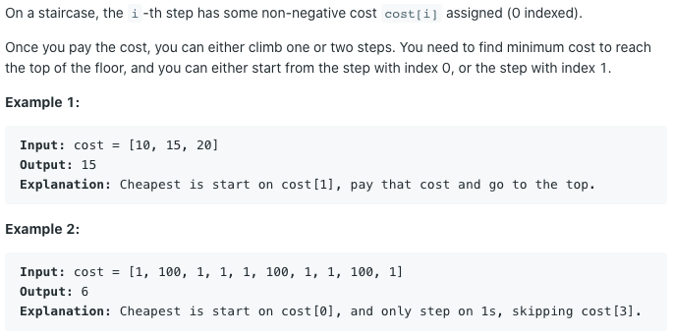
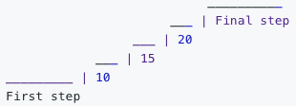
Bonus DP Problems
Min Cost Climbing Stairs
JumpGame2 (return shortest number of moves)
Coin Change
Write a function to compute the fewest number of
coins that you need to make up that amount.
If that amount of money cannot be made up by any combination of the coins, return -1. Input: coins = [1,2,5] amount = 11
Output: 3 Explanation: 11 = 5 + 5 + 1
Find More at
https://leetcode.com/tag/dynamic-programming/

Slide 30
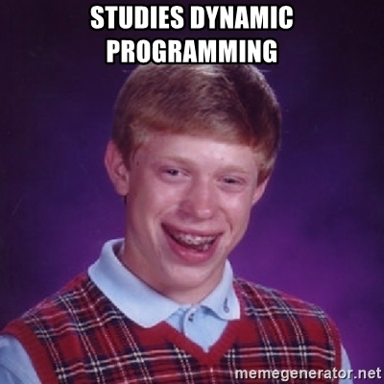


Slide 31
The End

